Slide 1
Hypothesis Testing, Z Test & T Test

Slide 2

Z score
How many Standard derivations away from the mean ?

Slide 3



Z score
$$z= \frac{x − μ}{σ}$$
$$z= \frac{5 −3}{1}$$
z $=2$

Slide 4
Hypothesis testing
Hypothesis means claims or assertion.
In statistical hypothesis, we claim about value of a single parameter, several parameter, or some entire probability distribution.
One example is the claim that µ = 30 where µ is the population mean of grade scored by student in Numerical Methods subject.

Slide 5
Hypothesis testing
In any hypothesis testing problem, there are two contradictory hypotheses under consideration.
One hypotheses might be the claim µ = 30 and the other µ > 30.
The objective is to decide based on sample information which of two hypotheses is correct.
The null hypothesis, denoted by Ho is the claim that is initially assumed to be true.
The alternative hypothesis, denoted by Ha, is the assertion that is contradictory to Ho.

Slide 6
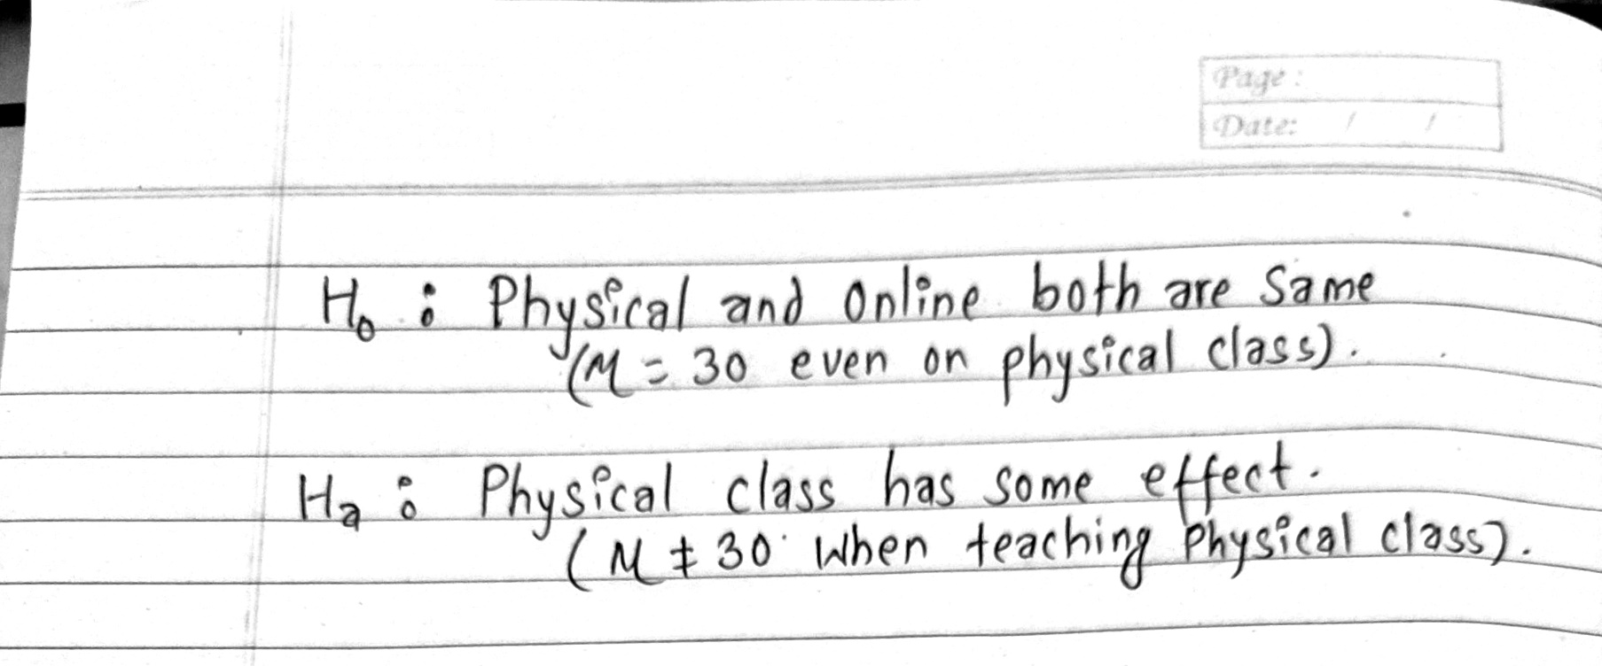
Hypothesis testing
In Math class, it is known that the mean grade score of student is 30. Some teachers are performing a research on 40 students that if taught physical class instead of online class, the mean grade score will be 35 with a standard deviation of 9. Can we verify that attending physical class has effect on the grade ?

Slide 7

Hypothesis testing

Slide 8
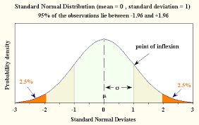
Z-Test vs T-Test
In inferential statistics, All we are trying to find is the probability of getting a certain sample mean.

Slide 9
Z-Test vs T-Test
If the sample size is relatively small, then it will form a t distribution. Hence we use t table to calculate the probability value.
Rule of Thumb: If n < 30, then use t table to look for the probability value.

